Slide 1
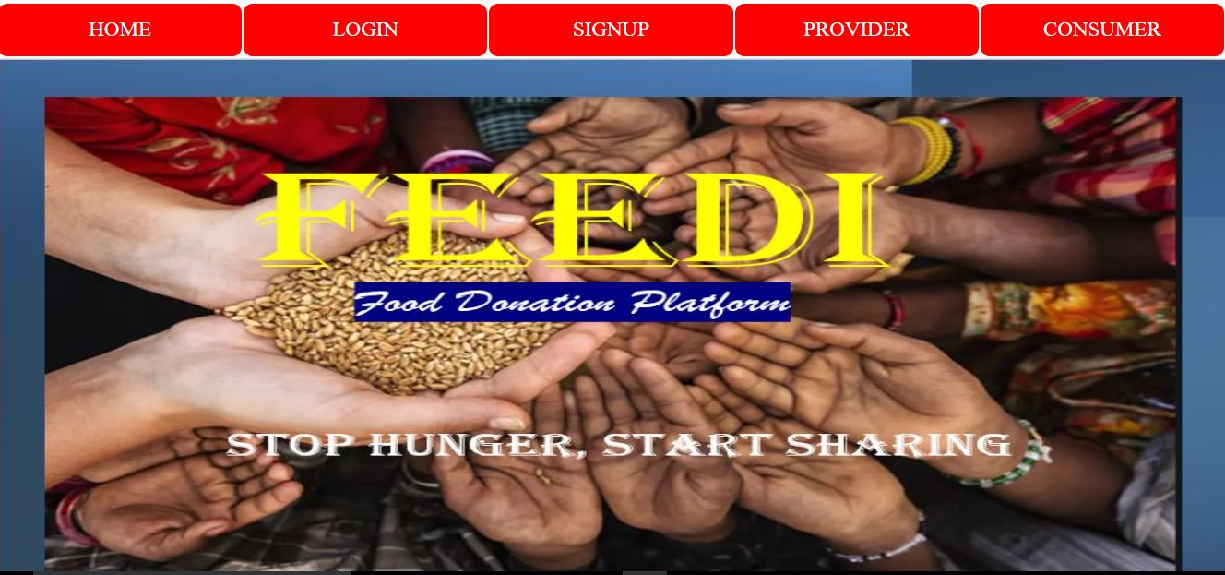



CALL FOR CODE 2021

Slide 2
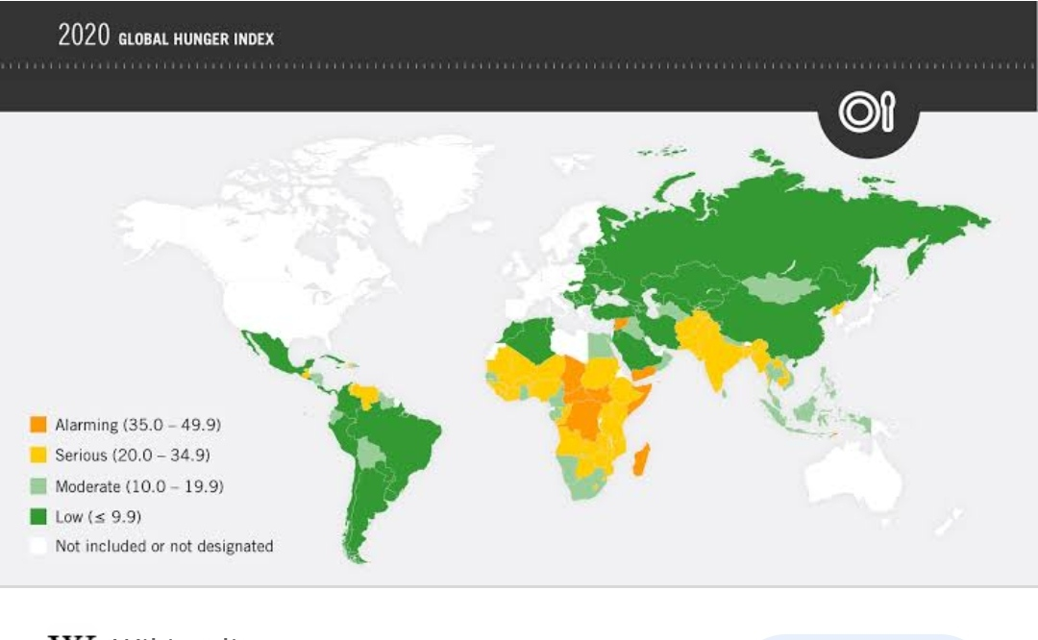
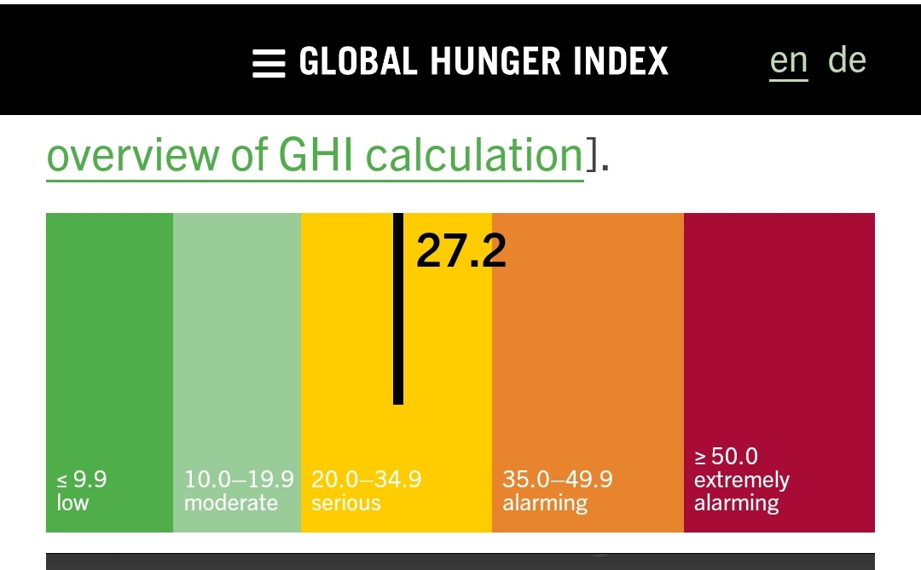
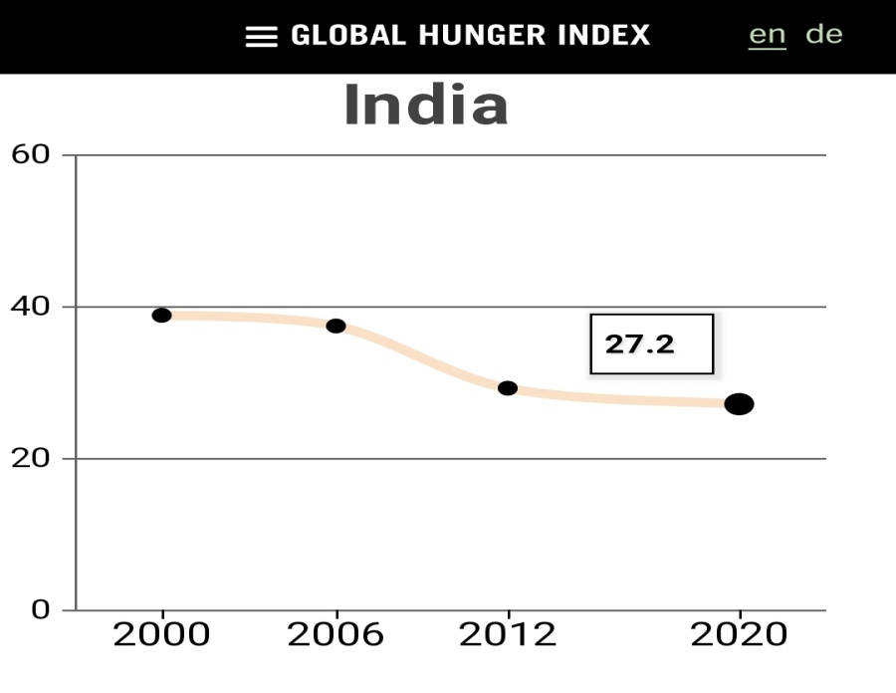
HUNGER INDEX

Slide 3


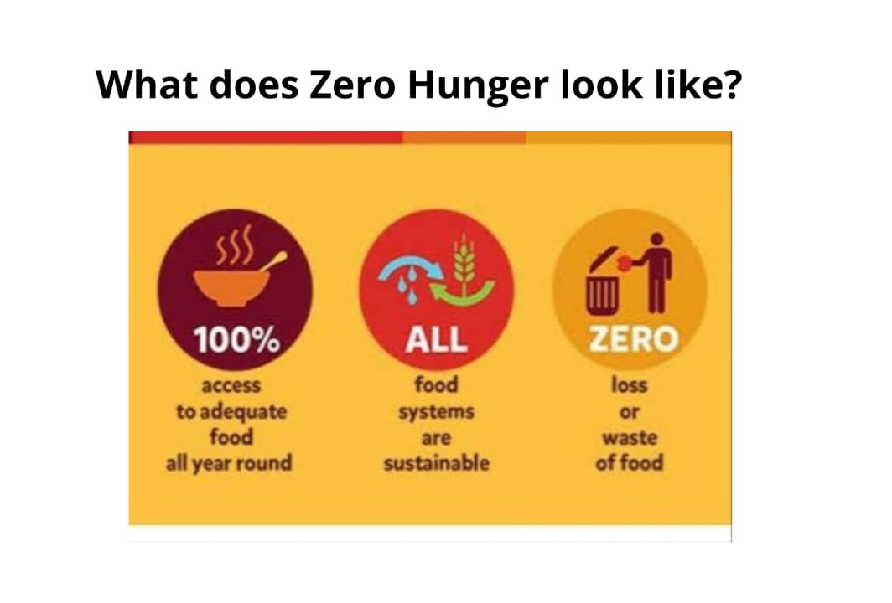

Slide 4

OUR SOLUTION

Slide 5


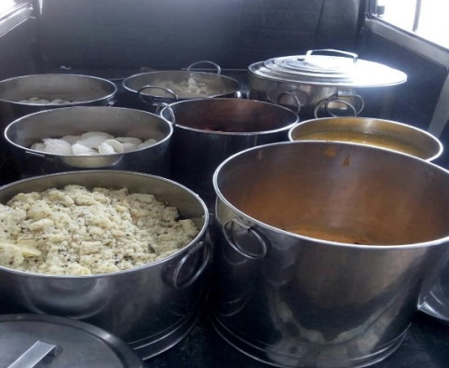

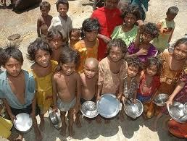

Food CONSUMER
Food PROVIDER

Slide 6



ARCHITECTURE
Platform powered by IBM Cloud
Food Provider (Donor)
1a
1b
1
Watson Image processing service
1
2a, 2b
Node.js
Watson Chatbot
Watson
Speech to text
Watson Translator
Food Consumer (NGO)
2c
Cloudant DB
Food providers – Are food donors
Uses the “Feedi” platform to upload food images
The uploaded food is processed by Watson image processing service to assess the quality of food and thereby accept/reject the food
Food Consumers – Are NGOs/ registered organization
Uses the “Feedi” platform to request food for the needy people.
Interacts with Feedi platform either through website or mobile application.
The platform also enables Watson chatbot to converse in interactive mode in local language

Slide 7
Feedi : Solution Roadmap
Phase1
July 31st, 2021
Phase2
Aug-Sep 2021
Phase3
Oct-Nov 2021
Web Application hosted on IBM Cloud
Language support - english
Mobile application
Watson Chatbot
Image processing using Watson image processing service
Location based distribution
Support of 2 more languages using Watson translator
Watson chatbot extended to accept audio as input use the Watson Speech to text to process audio
Feedi
Web Application
Feedi
Food Kiosk

Slide 8
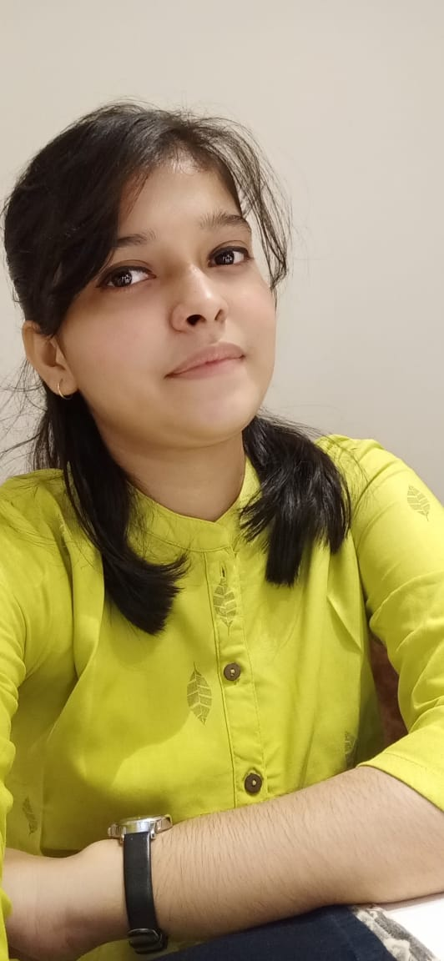



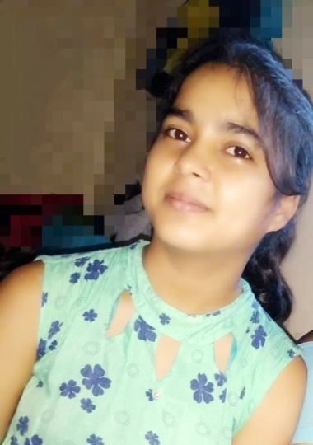

CONNECT TECH
“Feedi” Family
Khushi
Anjali
PATNA WOMEN’S COLLEGE
Rabab Fatma
Shalini Kumari
Ananya Singh

Slide 9


Thanks to IBM for providing us a platform to give back to the community.
Thanks to our Mentors (Phani Sir, Madan Sir, Srikanth Sir & Pallavi Ma’am) for the guidance and encouragement.

